Slide 2
Logical Reasoning in the Human Brain
Tom Morin
PhD Candidate

Slide 3

Logical reasoning is an essential basic feature of human cognition
Exit 1
Exit 2
Exit 3
???
Notes:
Humans have a unique ability to quickly solve new problems using logical reasoning.
The night sky gives us a great example of this. For millenia, people have been staring up at the sky, making meaning out of a seemingly random array of dots of light.
Say you were looking at the moon, and you noticed this pattern of shapes over the course of a few days. What would you predict to come next?
By making and testing these types of predictions, humans have built their understanding of the night sky and the world around them.
But the question of how the human brain performs these tasks remains unknown.

Slide 4
Impaired Logical Reasoning
Disorganized thinking
Poor planning and problem solving
Difficulty analyzing or processing information
Often present in Schizophrenia, Learning Disability, certain Dementias, and to a smaller extent in normal healthy aging
To better understand these deficits, we must first understand the regions that support logical reasoning in the healthy human brain.

Slide 5
Proposed Components of Logical Reasoning
2
1
Symbolic Processing: Convert complex visual information into simplified symbolic ideas containing only the essential information
Analogical Thinking: Determine how the symbols change and relate to each other. Predict what comes next.
3
Exit 1
Exit 1
Exit 2
Exit ?
Notes:
The “logical reasoning ability” required to solve the Raven’s progressive matrices task is a vague term though, and many different skills are likely involved in solving so we hypothesized that on this particular task, the human brain is employing two specific skills : (1) symbolic processing, where meaning is assigned to each of the symbols in the grid, and (2) analogical thinking, where participants figure out how the different symbols are related to each other.
From previous research, we know that anterior prefrontal cortex is activated during logical reasoning problems, but we wanted to know whether this activation was supporting symbolic processing, analogical thinking, or both.
Indeed, there are “multiple demands” within the logical reasoning that is required to solve the Raven’s task. Using this task in an fMRI study, we sought to learn whether different regions of the FPCN might be responsible for different components of logical reasoning. Specifically, we hypothesized that symbolic processing would activate anterior prefrontal cortex, while analogical thinking would more widely active the FPCN.
What made you think of this in particular, and why are you trying to understand them? What is symbolic processing used for, and what is analogic processing used for? Perhaps these should be the things to bring up before this point, rather than the particulars of the prior test used. Essentially, tell me why all of this is important in terms of understanding how humans think, and then give the info about Raven’s test in “methods” of how you’ll look into it?
So, in everyday life, when do we use one or the other? In dementia, or stroke, does the loss of one or the other create problems or opportunities for intervention? Or are they important in learning disabilities? It’s not critical for you to have a direct application, but helps to understand what you’re talking about with examples?

Slide 6
The Frontoparietal Control Network Supports Logical Reasoning
(Harding et al. 2015)
Central Problem: Within this network, are there separate regions supporting symbolic processing vs. analogical thinking?
Notes:
- About 100 years ago, the Raven’s Progressive Matrices Test was developed assess logical reasoning ability: the ability to identify patterns and make accurate predicitons about the world around us.
The most difficult trials on the Raven’s test consist of a three-by-three grid of symbols with one missing in the bottom right-hand corner. Advanced logical reasoning ability is required to solve these problems.
- Neuroscientists have studied the Raven’s test for decades, and brain scans show that the frontoparietal control network becomes active when participants solve the most difficult trials on the test.
- There is considerable debate about the function of the frontoparietal control network. It is activated by tasks that require logical reasoning, short term (working) memory, and increased mental effort, leading some to call it the multiple-demand network because it seems to respond to many different types of tasks.

Slide 7
Logical Reasoning Task
Symbolic Condition
Non-symbolic Condition
Analogical Thinking ✅
Symbolic Processing ✅
Analogical Thinking ✅
Symbolic Processing ❌
Notes:
- From the computational modelling, we hypothesized that the brain might have different regions responsible for analogical thinking and symbolic processing.
- We designed a simplified version of the Raven’s matrices task to explicitly compare the two cognitive processes. As a control condition, we designed problems that required analogical thinking (using information from the whole picture to identify what belongs in the blank white square). In a second Symbolic condition, we designed problems that required symbolic processing in addition to analogical thinking.

Slide 8
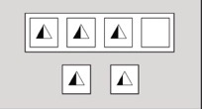
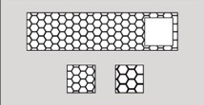
Methodology
27 Healthy Young Adults
18 – 35 years old
10 M, 17 F
396 trials of the task
1 hour MRI scanning session

Slide 9
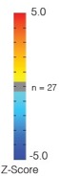
fMRI Reveals Distinct Brain Systems Activated for Symbolic Reasoning
Symbolic
Non-symbolic
ETAC Corrected
for mult. comp.
Notes:
Using functional MRI, we scanned participants brains while they completed hundreds of trials on our task, and we derived brain activity maps for each condition
Regions outlined in green activated for both conditions, suggesting that these regions are important for analogical thinking.
Regions in red activated only for the symbolic condition. These regions are important for symbolic processing.

Slide 10
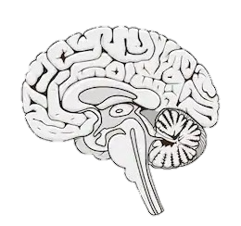
A Symbolic Processing Subsystem within the Frontoparietal control network
Anterior Subsystem: Symbolic processing
Posterior subsystem: Analogical thinking
Notes:
- In a simplified schematic, we can present our results again.
The fronto-parietal network (green) activates for both conditions, so we frame it as a general-purpose mechanism for applying reasoning skills
The rostro-lateral prefrontal cortex and dorsomedial prefrontal cortex (red) are activated in the symbolic condition only, and we interpret it as a region important for symbolic processing (as opposed to its previous association with task difficulty)

Slide 11
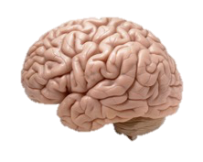
Conclusions
Our study identifies a subsystem of the frontoparietal control network that processes symbolic information during reasoning tasks.
Future work in our lab will examine the effect of age on logical reasoning, with respect to these brain regions.
Exit 1
Exit 2
Exit 3
???

Slide 12
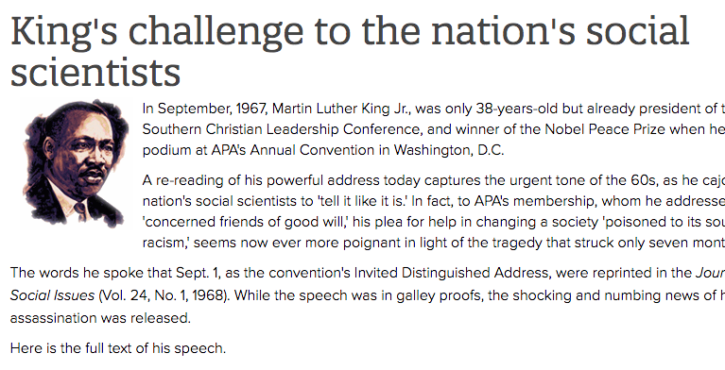

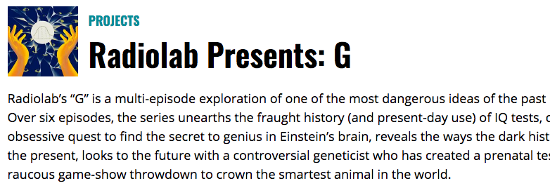
Broader Impacts
https://www.apa.org/monitor/features/king-challenge
https://www.obama.org/anguish-and-action/
https://www.wnycstudios.org/podcasts/radiolab/projects/radiolab-presents-g

Slide 13
Thank You!
GPN
Shelley Russek
Sandi Grasso
Nazifa Haque
Qualifying Exam Committee
Chantal Stern
Joe McGuire
Mike Hasselmo
Cognitive Neuroimaging Center
Jay Bohland
Shruthi Chakrapani
Stern Lab
Chantal Stern
Allen Chang
Rachel Nauer
Matt Dunne
Stamati Liapis
Kylie Moore
Kelli Tahaney
Tashauna Blankenship
Weida Ma
Sheila Yee
Boston University
David Somers
Funding
NSF Major Research Instrumentation Award 1625552
ONR MURI Award N00014-16-1-2832
ONR DURIP Award N00014-17-1-2304

Slide 15
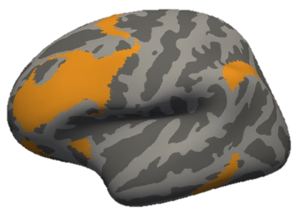
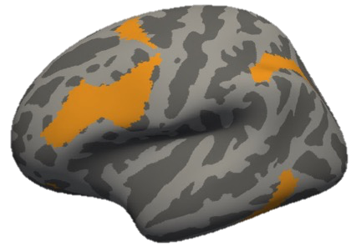
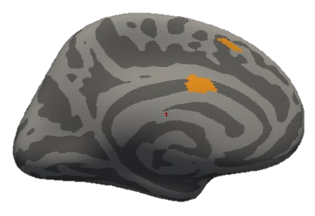
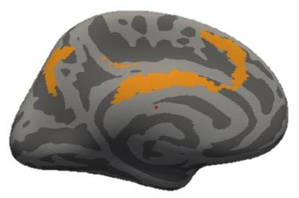

Slide 16
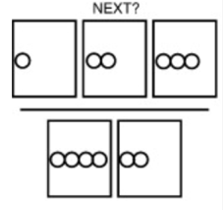
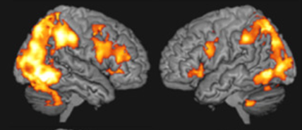
The Frontoparietal Control Network Supports Logical Reasoning
Frontoparietal Control Network
(Melrose, et al. 2018)
Central Problem: During a logical reasoning task, can we detect separate neural signals supporting symbolic processing vs. analogical thinking?
Notes:
- About 100 years ago, the Raven’s Progressive Matrices Test was developed assess logical reasoning ability: the ability to identify patterns and make accurate predicitons about the world around us.
The most difficult trials on the Raven’s test consist of a three-by-three grid of symbols with one missing in the bottom right-hand corner. Advanced logical reasoning ability is required to solve these problems.
- Neuroscientists have studied the Raven’s test for decades, and brain scans show that the frontoparietal control network becomes active when participants solve the most difficult trials on the test.
- There is considerable debate about the function of the frontoparietal control network. It is activated by tasks that require logical reasoning, short term (working) memory, and increased mental effort, leading some to call it the multiple-demand network because it seems to respond to many different types of tasks.

Slide 17
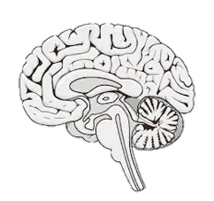
The Frontoparietal Control Network Supports Logical Reasoning
Frontoparietal Control Network
Central Problem: During a logical reasoning task, can we detect separate neural signals supporting symbolic processing vs. analogical thinking?
Notes:
- About 100 years ago, the Raven’s Progressive Matrices Test was developed assess logical reasoning ability: the ability to identify patterns and make accurate predicitons about the world around us.
The most difficult trials on the Raven’s test consist of a three-by-three grid of symbols with one missing in the bottom right-hand corner. Advanced logical reasoning ability is required to solve these problems.
- Neuroscientists have studied the Raven’s test for decades, and brain scans show that the frontoparietal control network becomes active when participants solve the most difficult trials on the test.
- There is considerable debate about the function of the frontoparietal control network. It is activated by tasks that require logical reasoning, short term (working) memory, and increased mental effort, leading some to call it the multiple-demand network because it seems to respond to many different types of tasks.

Slide 18
Central Problem
During a logical reasoning task, can we detect separate neural signals supporting symbolic processing vs. analogical thinking?
Frontoparietal Control Network

Slide 19
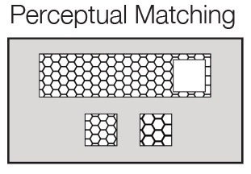
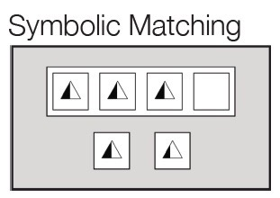

Slide 20
Conditions are Matched for Difficulty
Notes:
- In our new task, conditions are matched for accuracy, and response time. We argue that this means they are essentially the same difficulty level, and that brain activity from these conditions is the result of different reasoning skills, not of task difficulty.

